Slide 1
Experimentally Informed Site-Specific Substitution Models Substantially Deepen Divergence Estimates
Notes:
Color scheme
black = "black”
blue = "#439FC3”
green = "#397262”
orange = "#F9842A”
red = "#B52A24”
pink = "#CC79A7"

Slide 2
Notes
The raw figures come from `figures.ipynb` in this directory.
If you don’t change the size of the output figure you should be able to plop them into this presentation to produce the final figures.

Slide 3
MAIN FIGURES

Slide 4
Model feature comparison

Slide 5
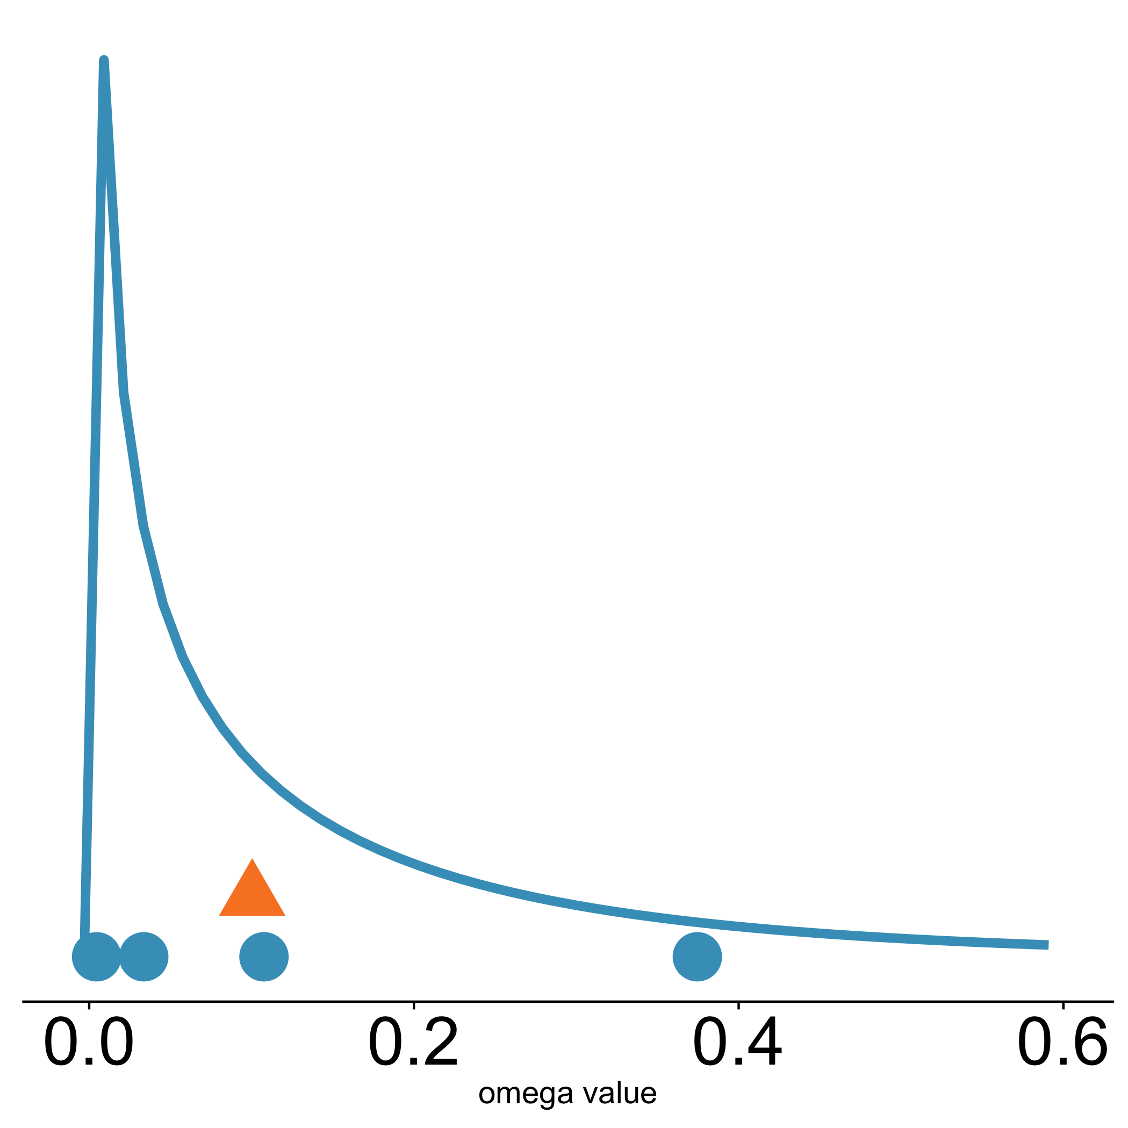
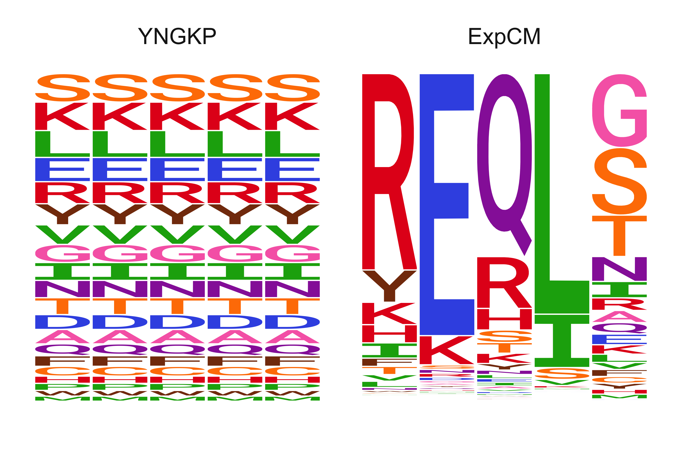

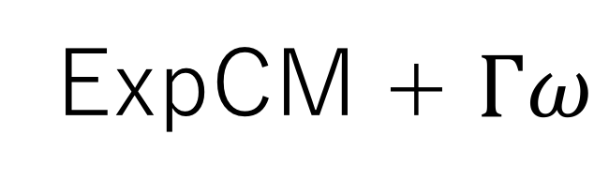
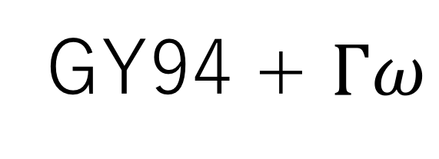
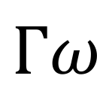
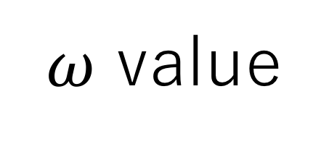
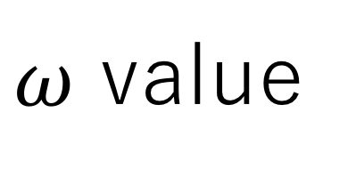
A
B
C
Uniform stationary state
Site-specific stationary state
Site-specific stationary state
$Γω$ rate variation
$ω$ value
$$Γω$$
GY94
single value
GY94 + $Γω$
ExpCM
ExpCM + $Γω$
$ω$ value

Slide 6
Decay to stationary state

Slide 7
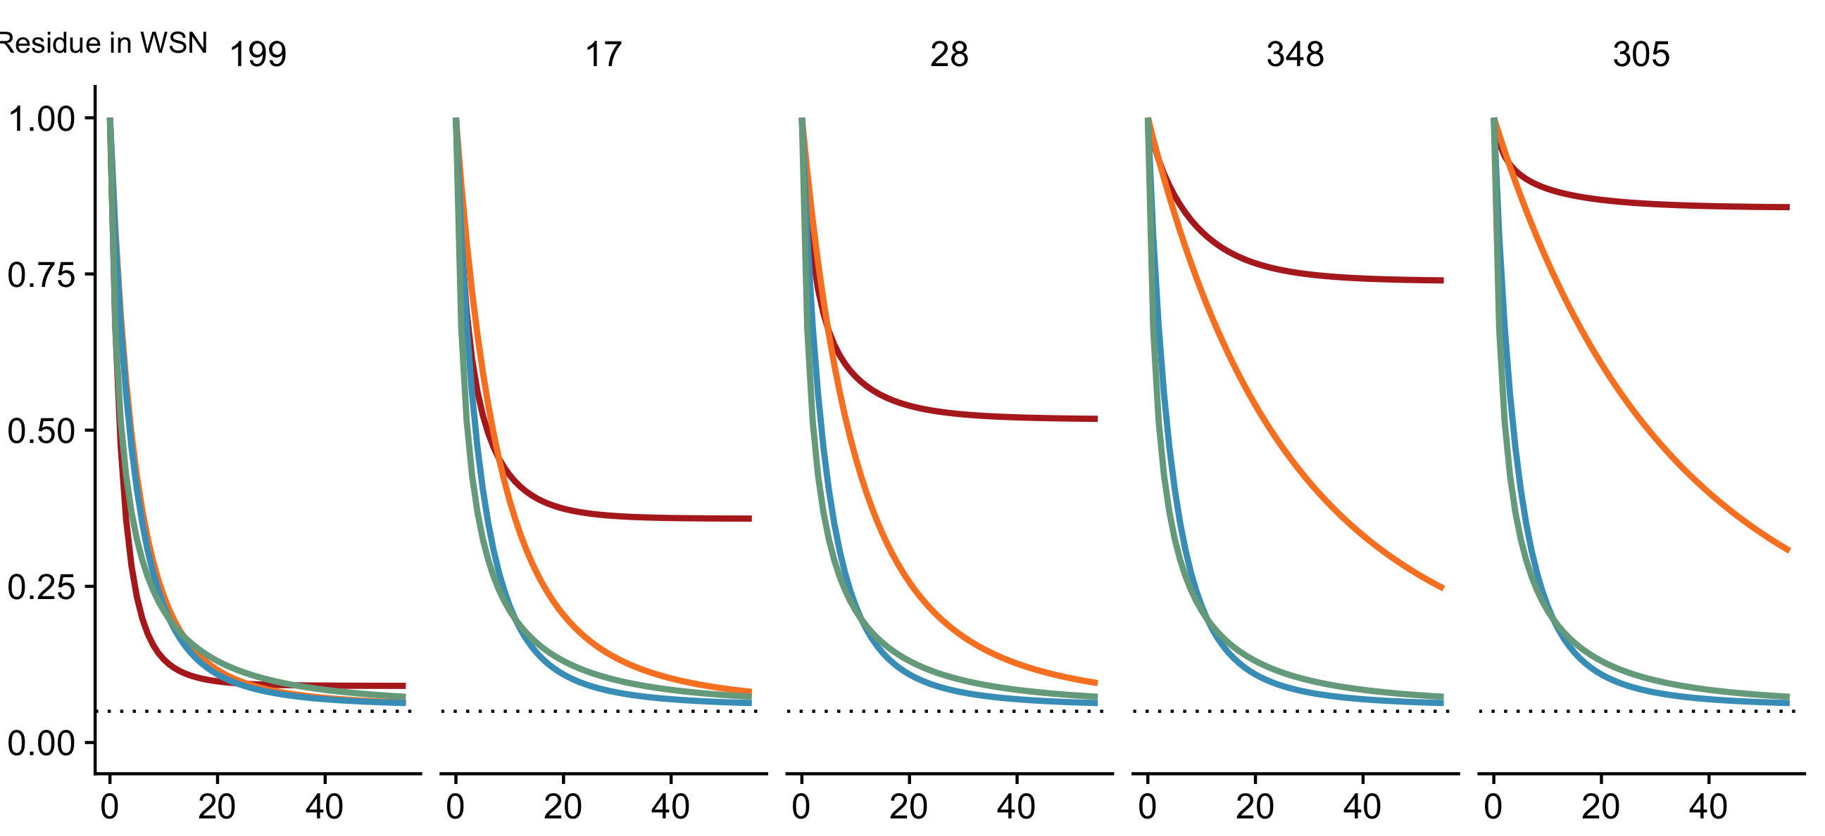
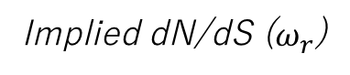
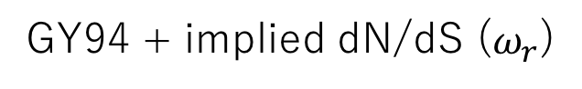
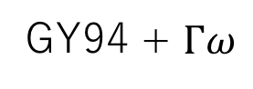
199
17
28
348
305
Site in HA
0.91
0.46
0.36
0.12
0.10
Implied dN/dS ($ω_{r}$)
Model
Expected pairwise amino-acid identity
ExpCM
GY94
GY94 + $Γω$
GY94 + implied dN/dS ($ω_{r}$)
Branch length (codon substitutions per site)

Slide 8
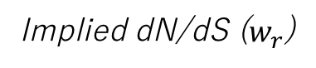
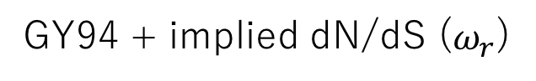
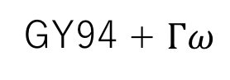
199
17
28
348
305
Site in HA
0.91
0.46
0.36
0.12
0.10
Implied dN/dS ($w_{r}$)
Model
ExpCM
Expected pairwise amino-acid identity per site
GY94
GY94 + $Γω$
GY94 + implied dN/dS ($ω_{r}$)
Branch length (codon substitutions per site)

Slide 9
Simulations

Slide 10
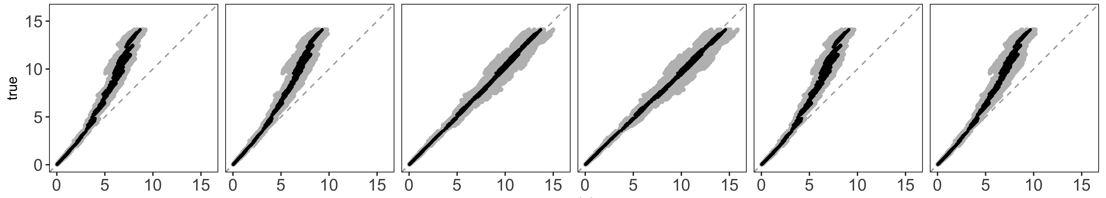
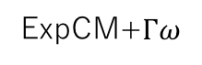
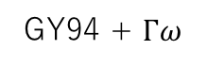
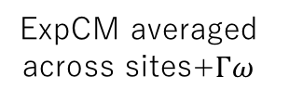
Actual branch length
GY94
GY94 + $Γω$
ExpCM
ExpCM+$Γω$
ExpCM averaged across sites
ExpCM averaged across sites+$Γω$
Branch length optimized by the model

Slide 11
Model Comparison Trees

Slide 12
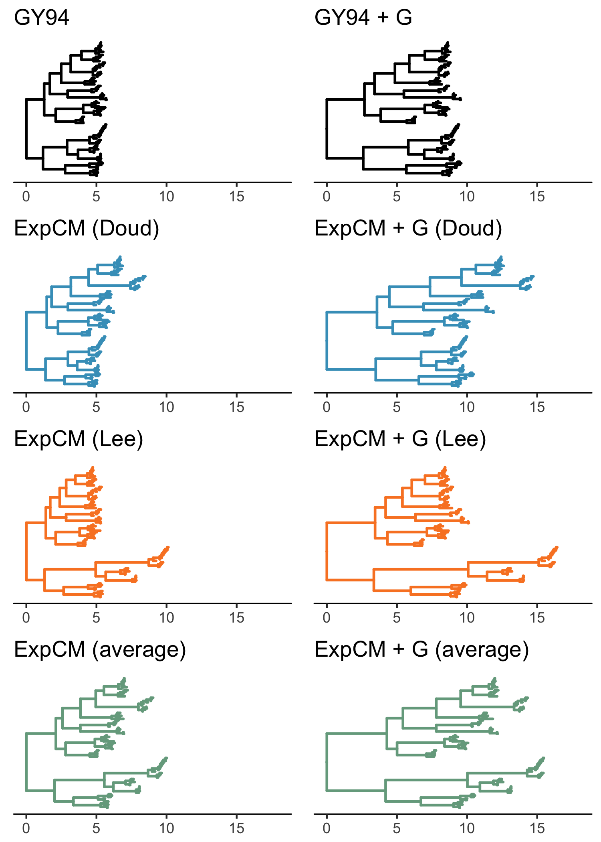
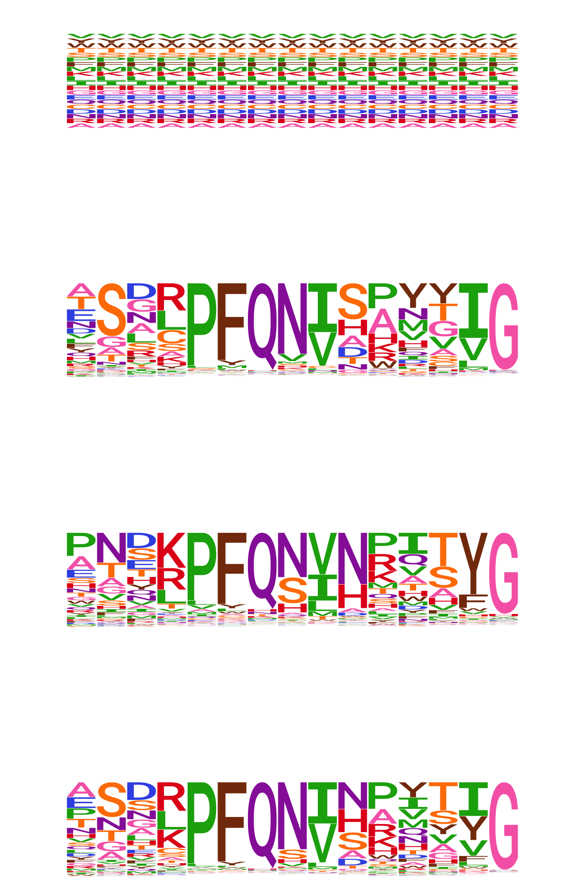

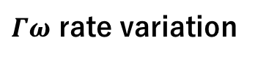
No rate variation
$Γω$ rate variation
GY94
ExpCM + $Γω$
ExpCM (H1)
ExpCM (H3)
ExpCM (H1+H3 avg)

Slide 13
Competing effects

Slide 14
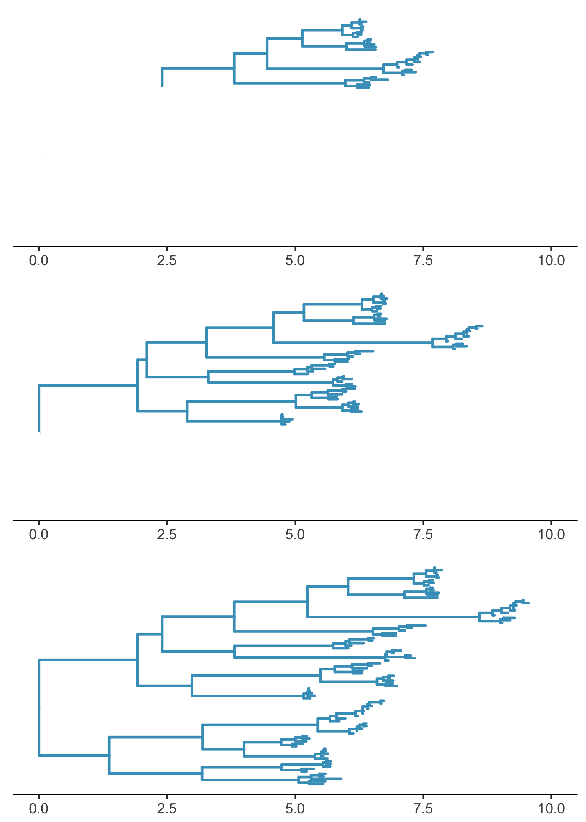
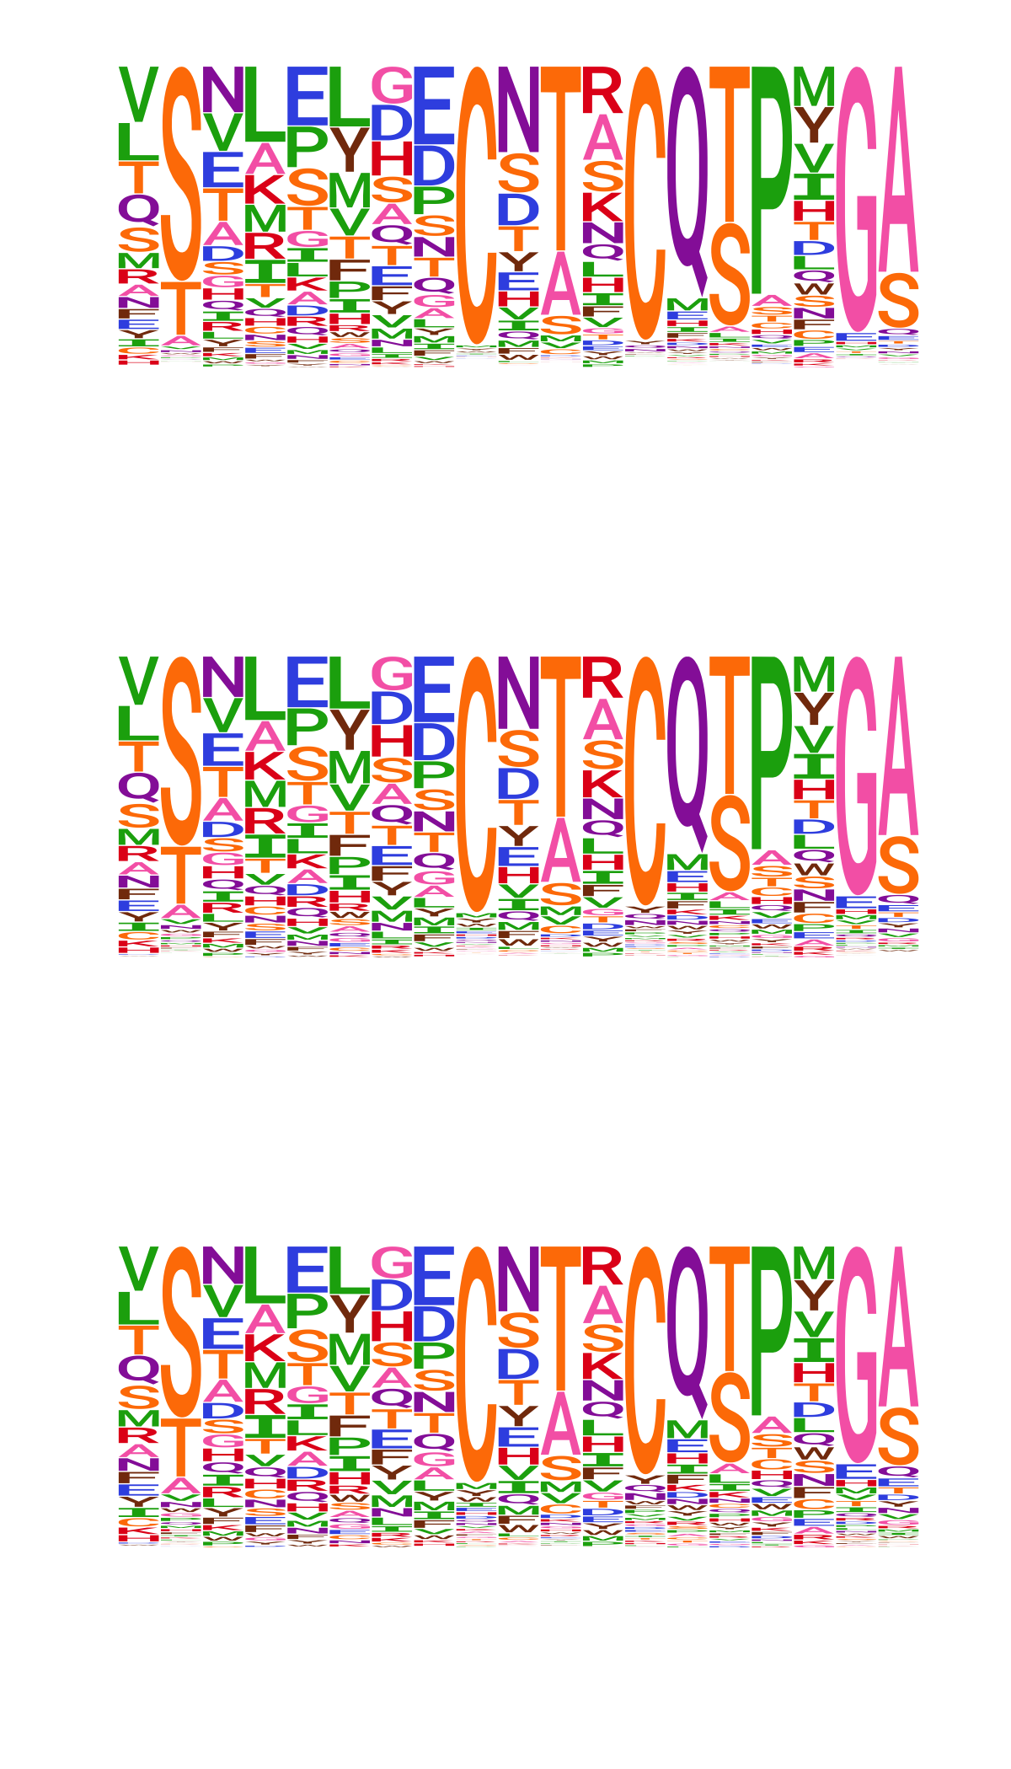
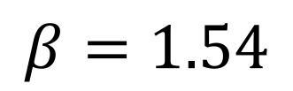
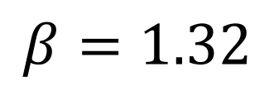
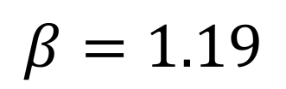
$$β=1.54$$
$$β=1.32$$
$$β=1.19$$

Slide 15
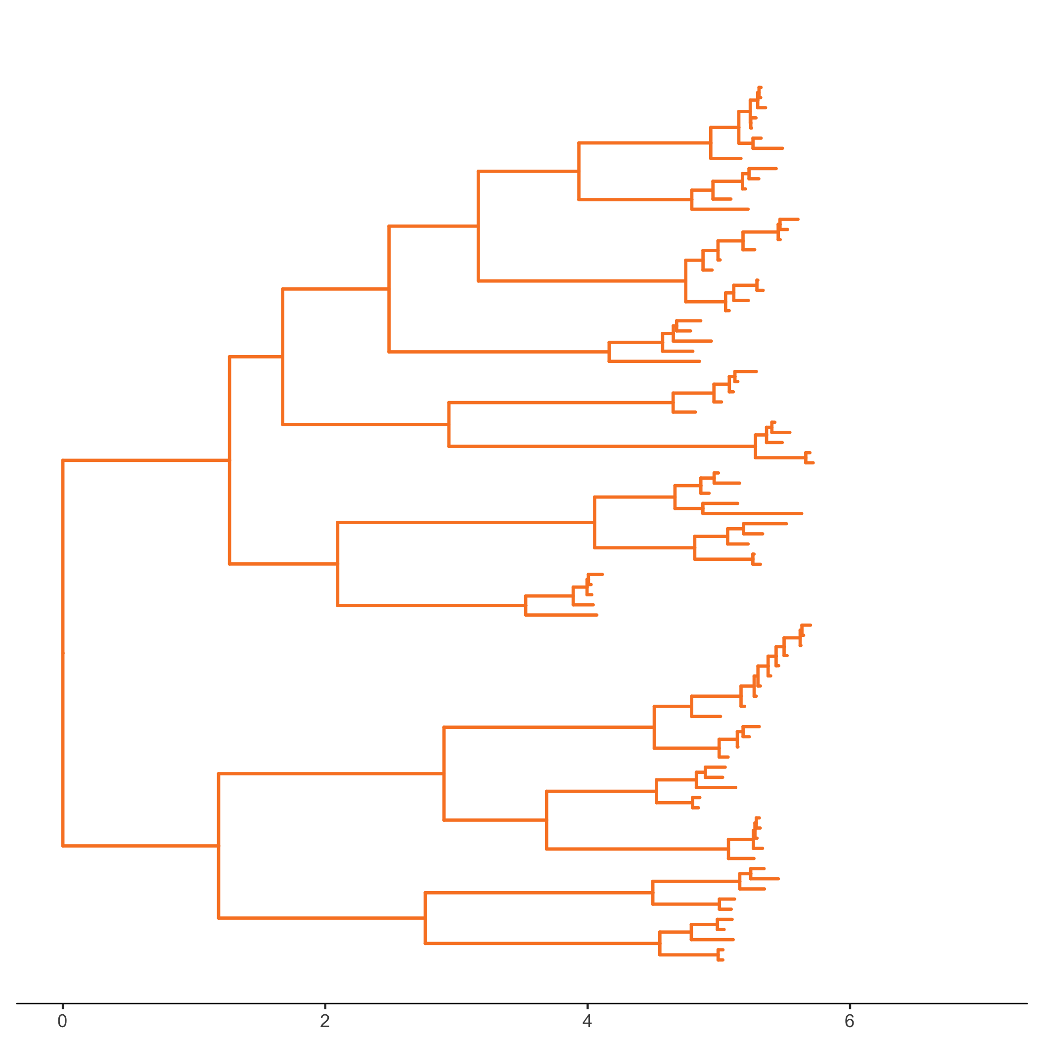
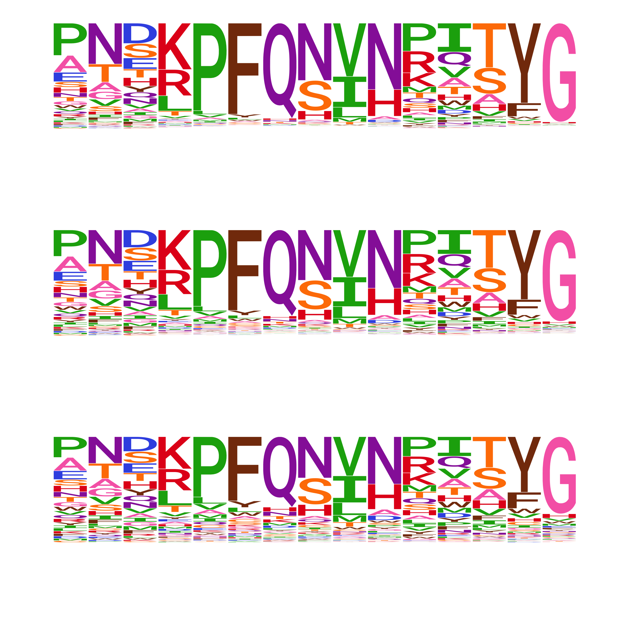
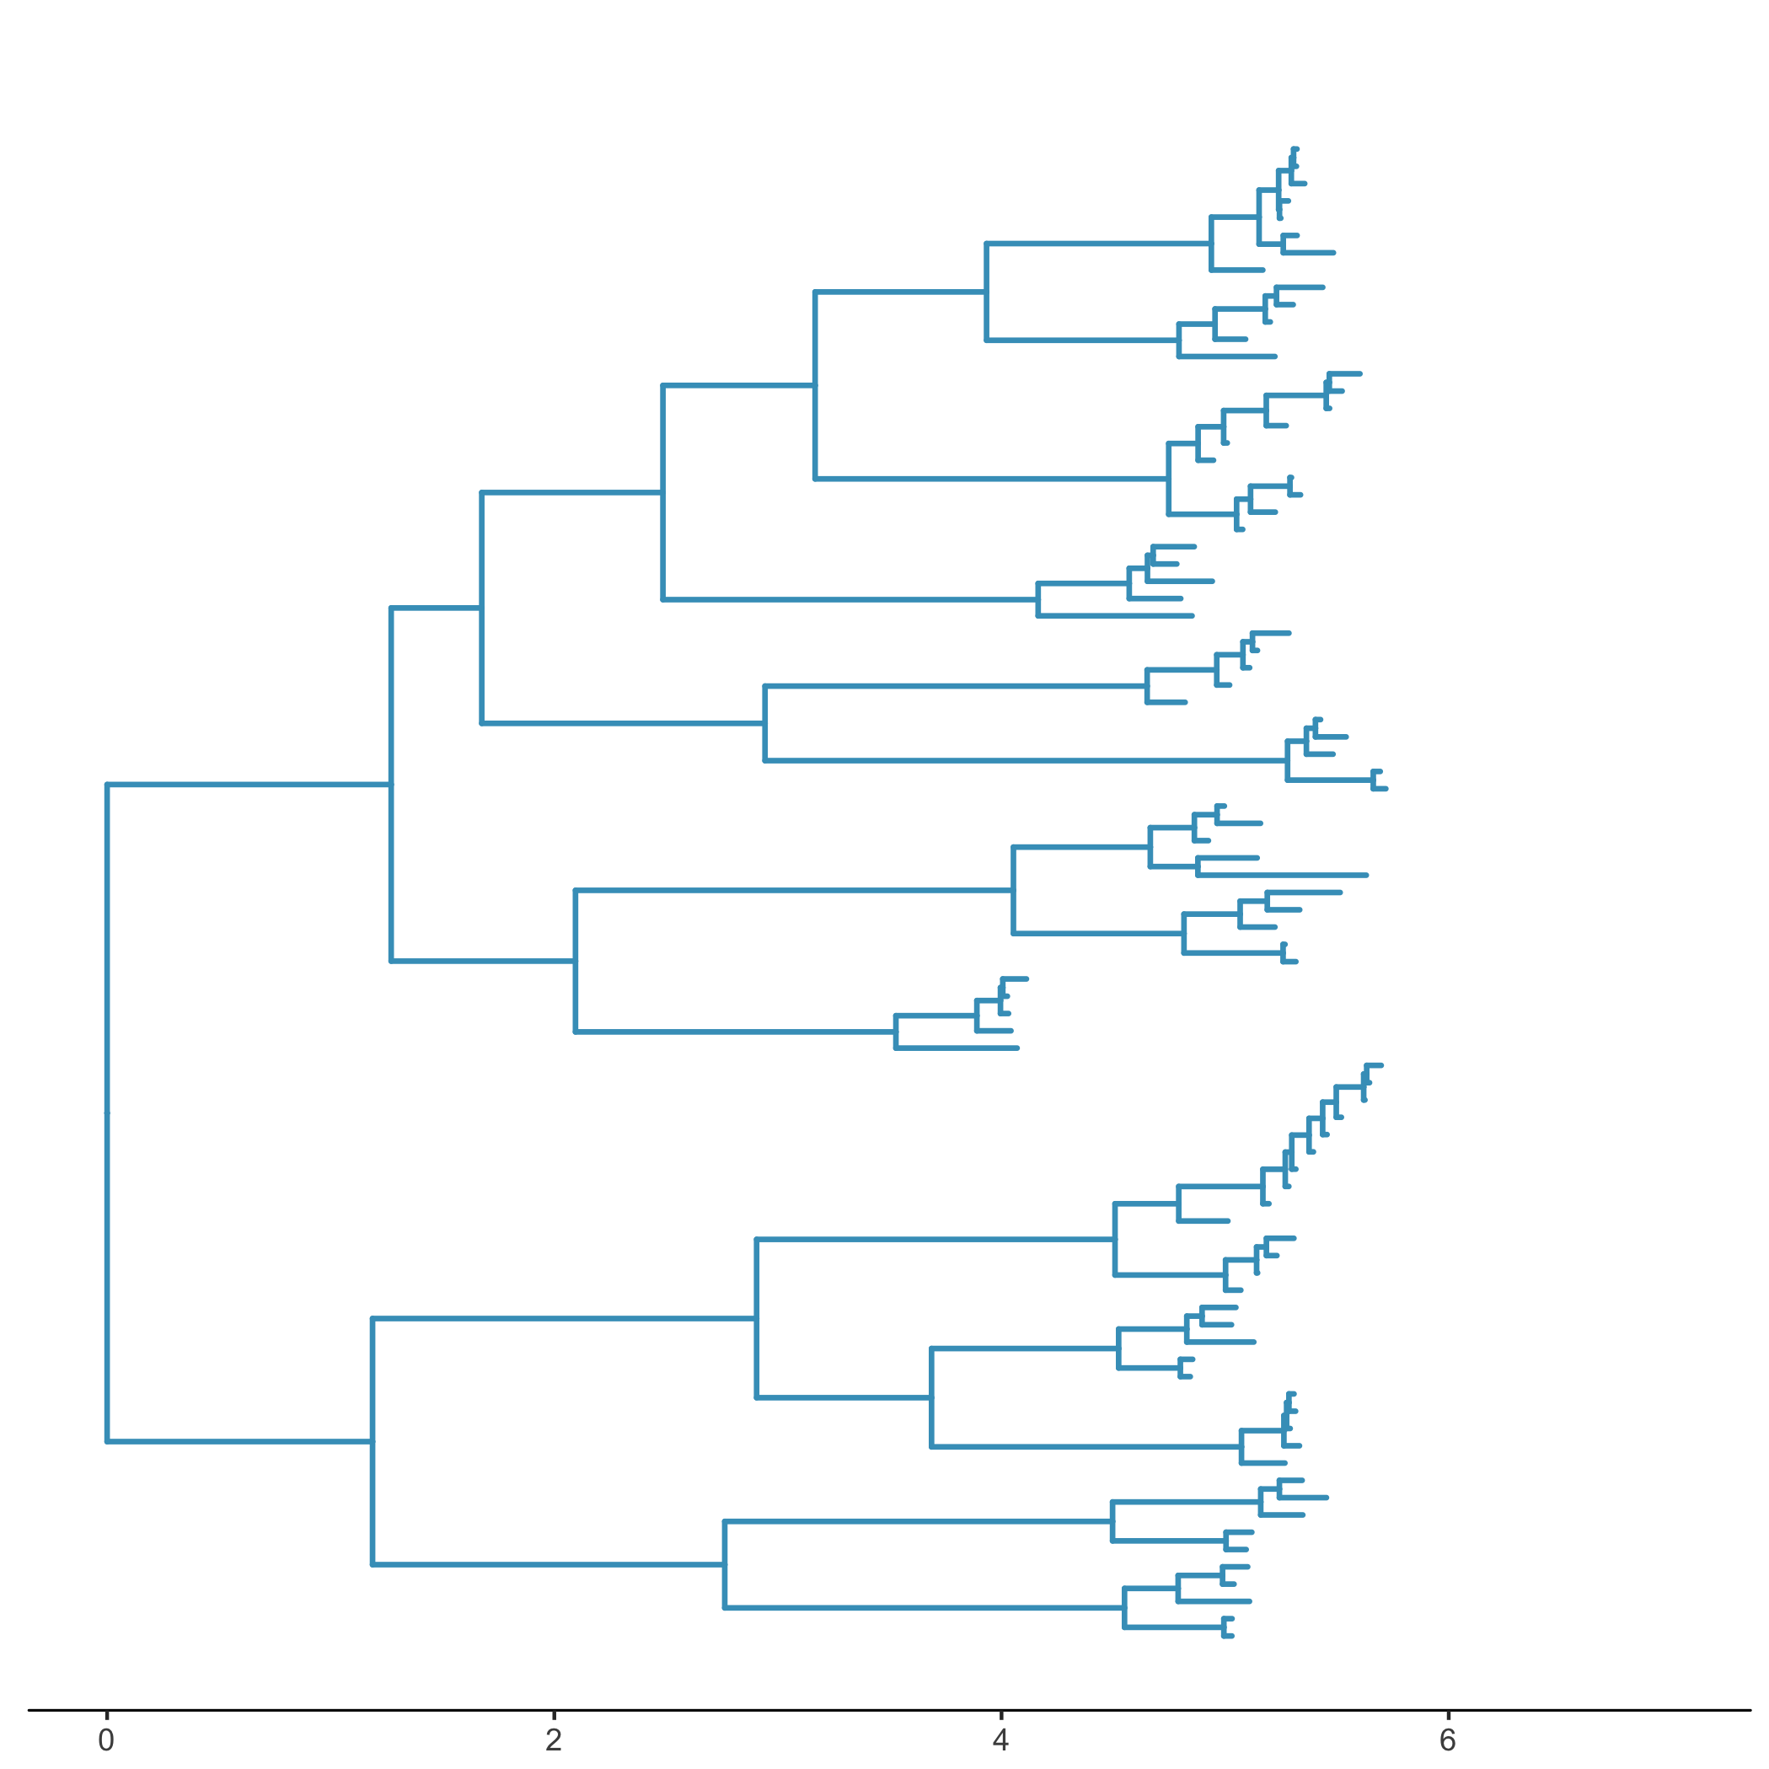

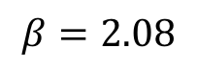
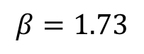
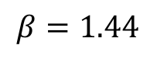
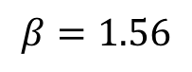
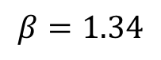
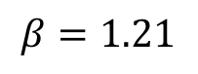
ExpCM(H3 prefs)
high
intermediate
low
$$β=2.08$$
intermediate
low
$$β=1.73$$
high
$$β=1.44$$
ExpCM(H1 prefs)
low
$$β=1.56$$
low
intermediate
$$β=1.34$$
high
intermediate
$$β=1.21$$
high

Slide 16
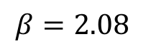
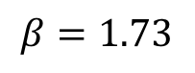
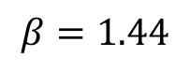
low
$$β=2.08$$
intermediate
high
$$β=1.73$$
intermediate
low
high
$$β=1.44$$
low
$$β=1.56$$
low
intermediate
$$β=1.34$$
high
intermediate
$$β=1.21$$
high

Slide 17
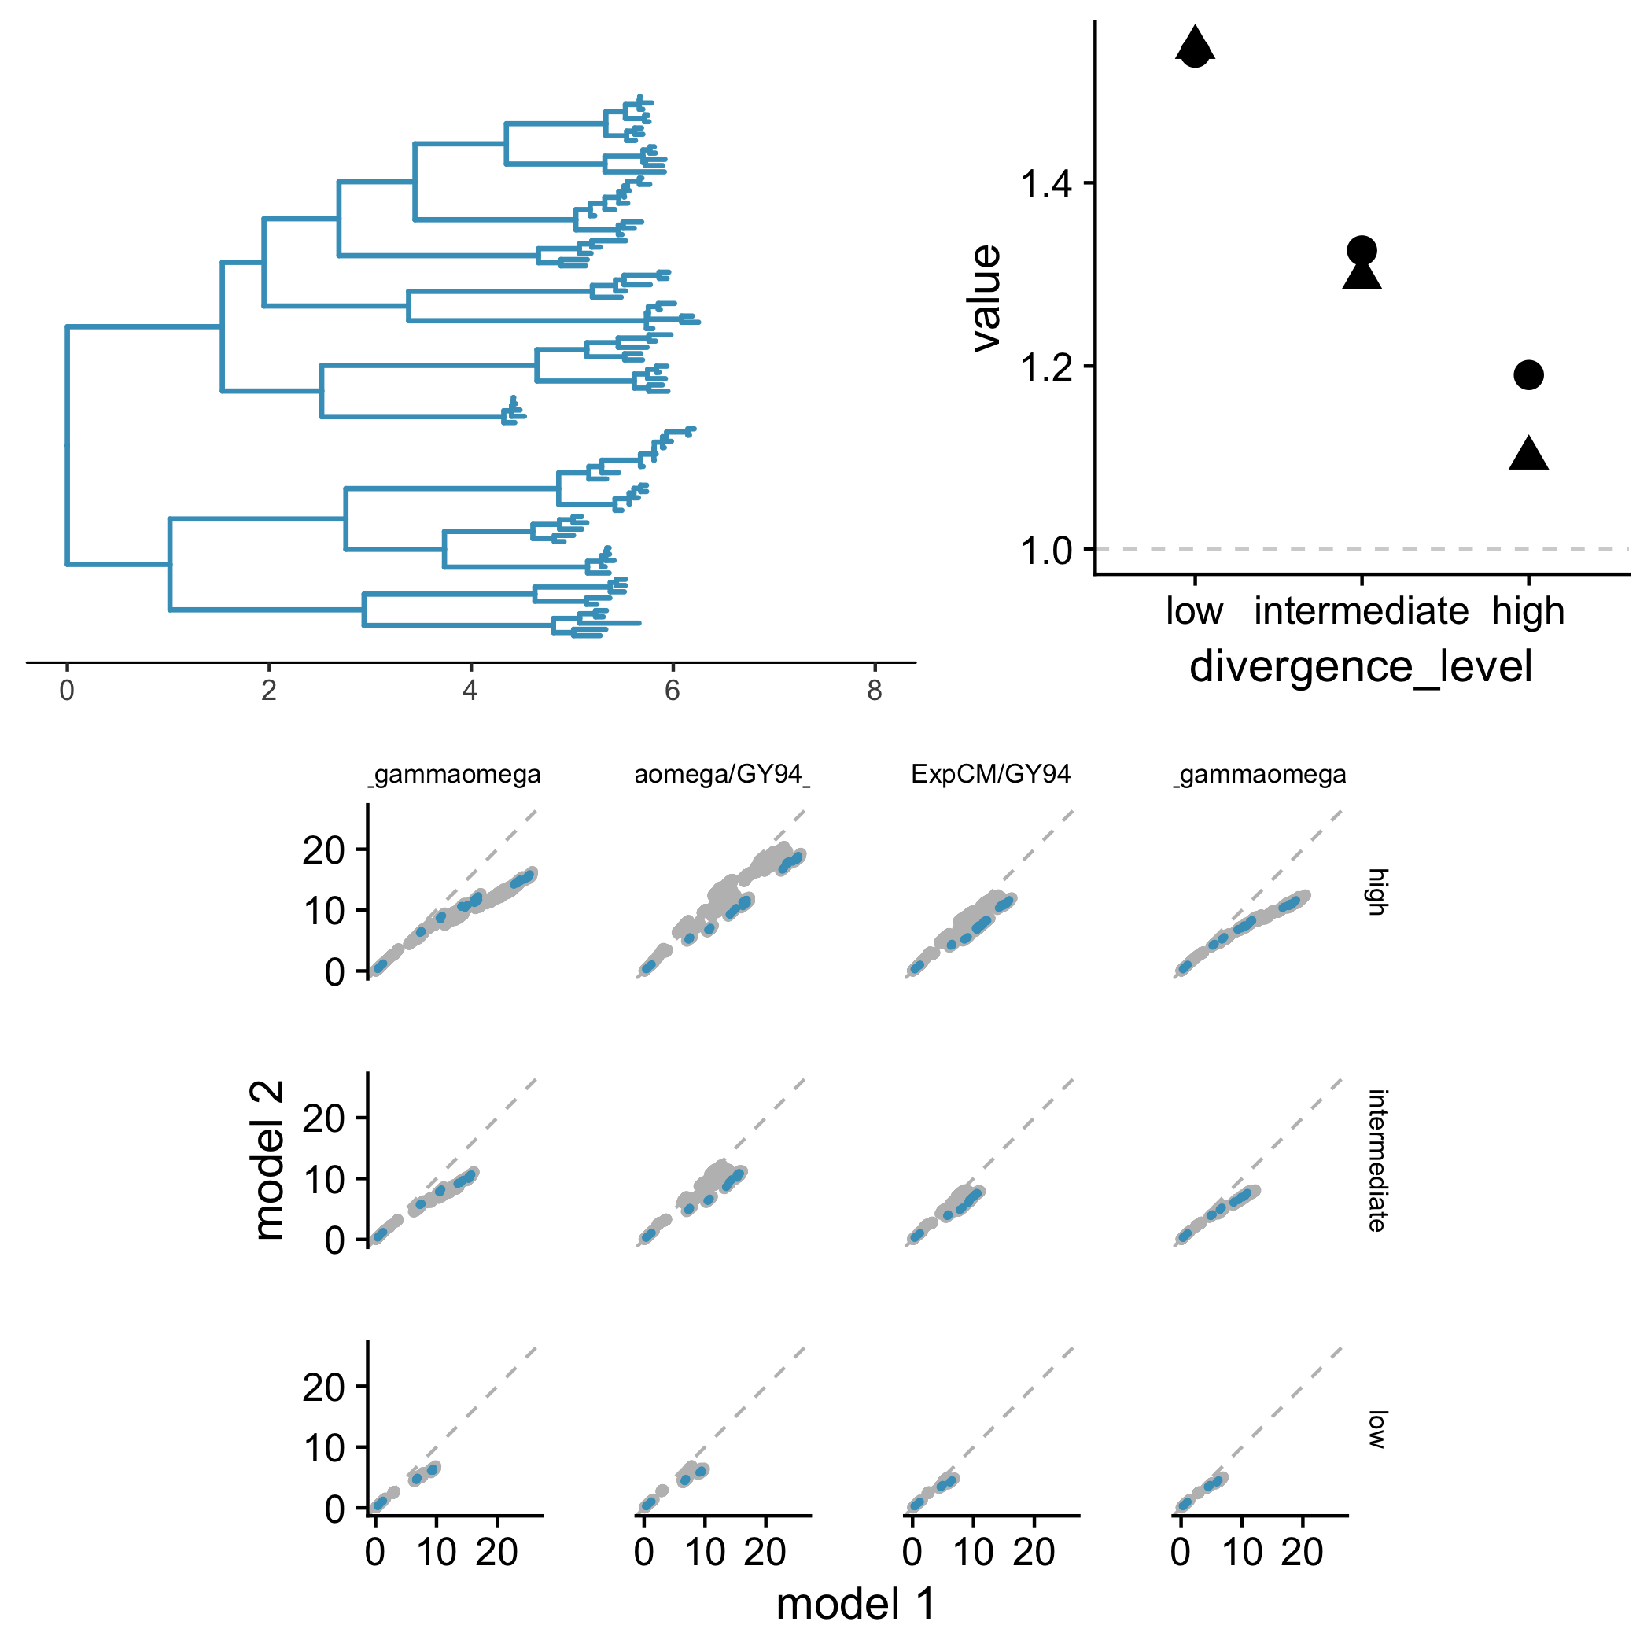
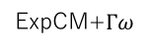

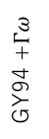
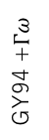
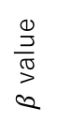
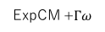
A
B
high
ExpCM
ExpCM +$Γω$
low
$β$ value
intermediate
low
high
intermediate
C
ExpCM
GY94 +$Γω$
GY94
GY94
high
Branch from focal sequence?
Yes
No
ExpCM
GY94 +$Γω$
GY94
GY94
intermediate
ExpCM
GY94 +$Γω$
GY94
GY94
low
ExpCM+$Γω$
ExpCM+$Γω$
ExpCM
YNGKP M5

Slide 18
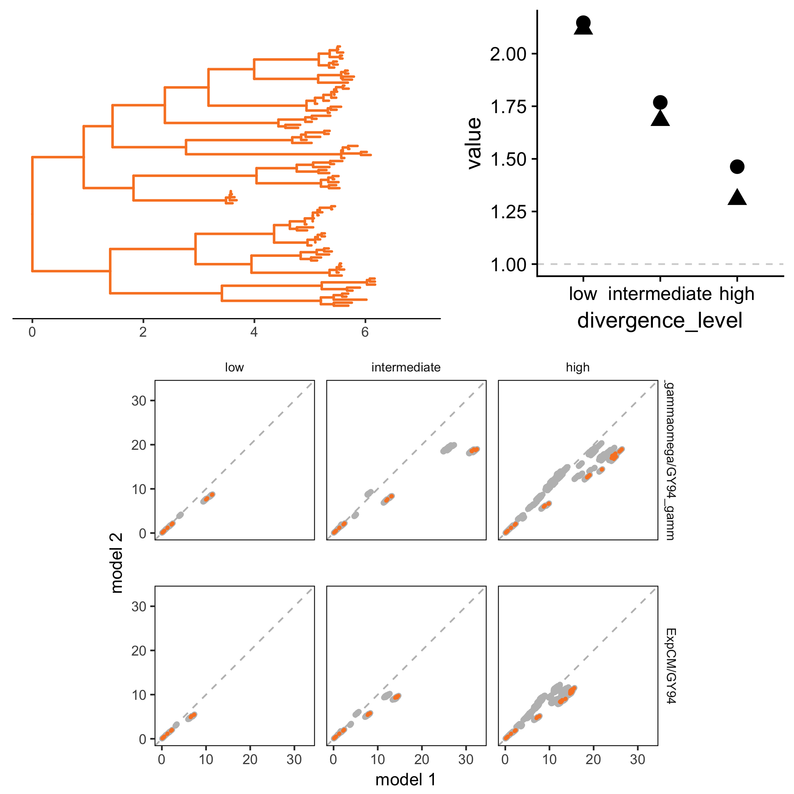
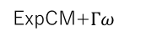
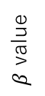
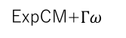
A
B
high
ExpCM
ExpCM +$Γω$
intermediate
$β$ value
low
low
high
intermediate
C
low
intermediate
high
Branch from focal sequence?
GY94 +$Γω$
Yes
No
ExpCM+$Γω$
ExpCM+$Γω$
ExpCM+$Γω$
GY94
ExpCM
ExpCM
ExpCM

Slide 19
`phylobayes`

Slide 20
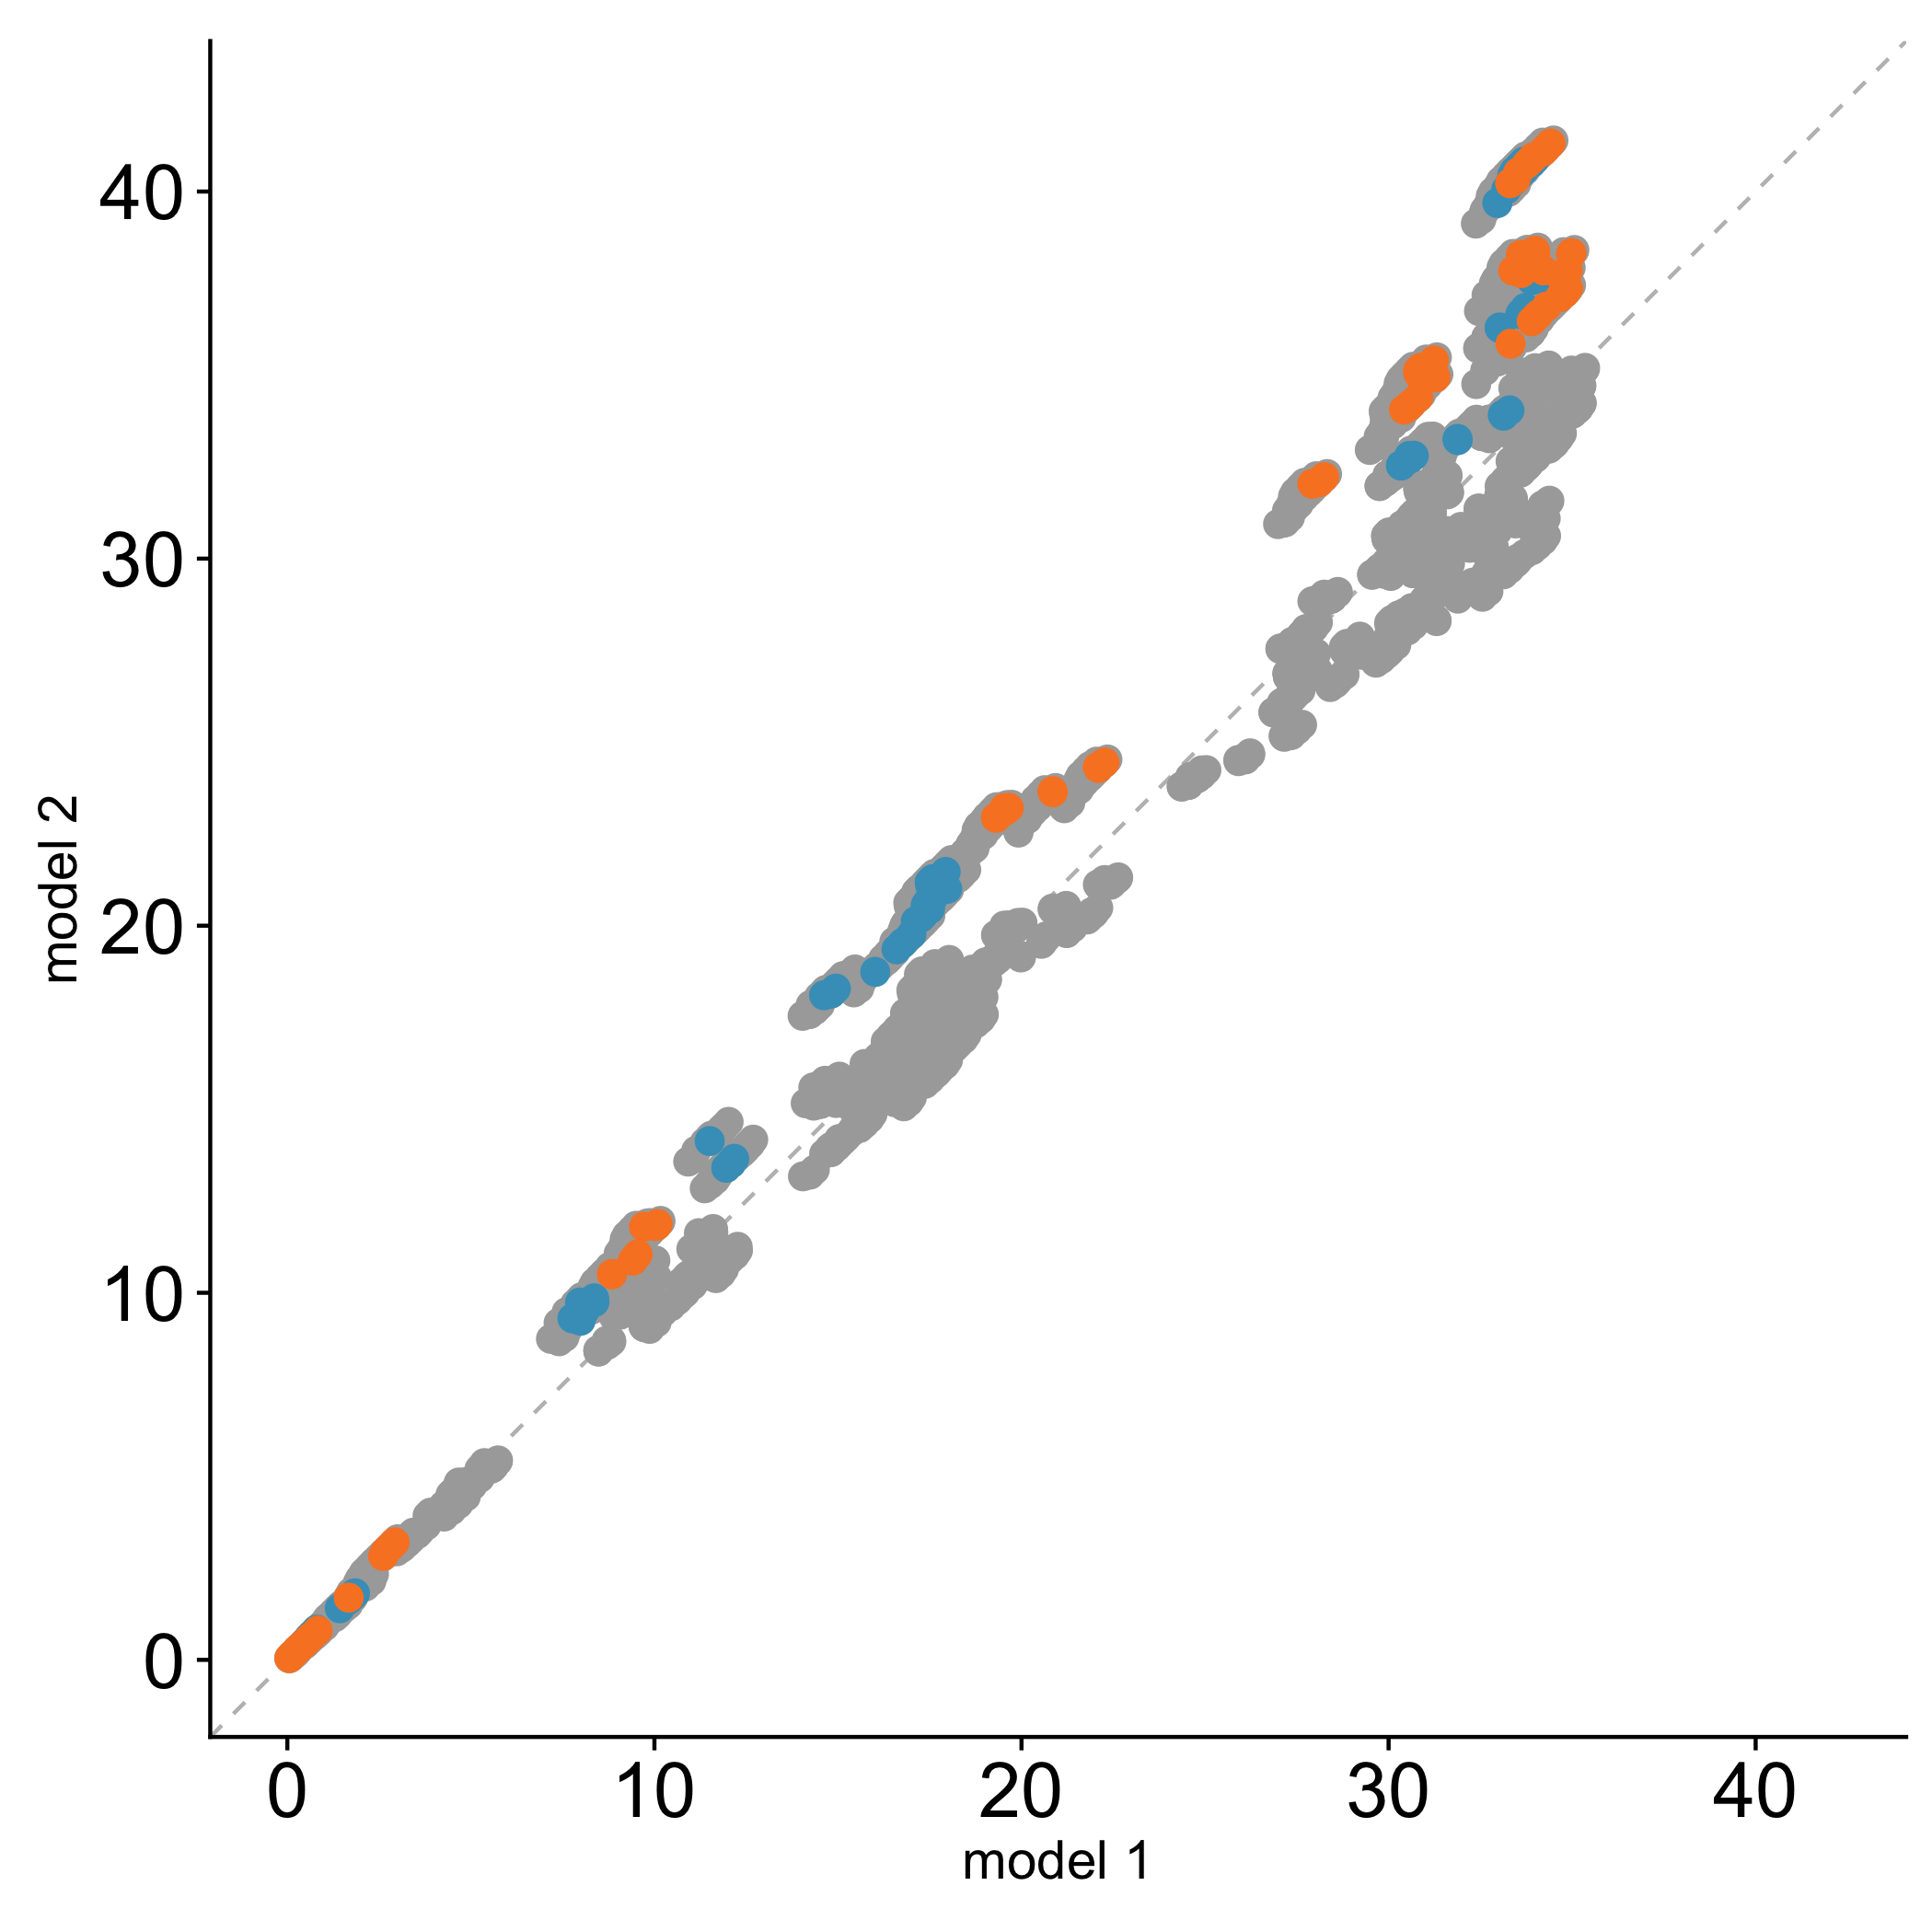
Branch from
H1
H3
ExpCM (H1+H3 avg) normalized branch length
phylobayes normalized branch length

Slide 21
SUPPLEMENTAL FIGURES

Slide 22
Preference Sets

Slide 23
Notes:
Doud, stringency 1.21

Slide 24
Notes:
Lee stringency 1.46

Slide 25
Notes:
Average, stringency 1.82

Slide 26
Full Experiments

Slide 27
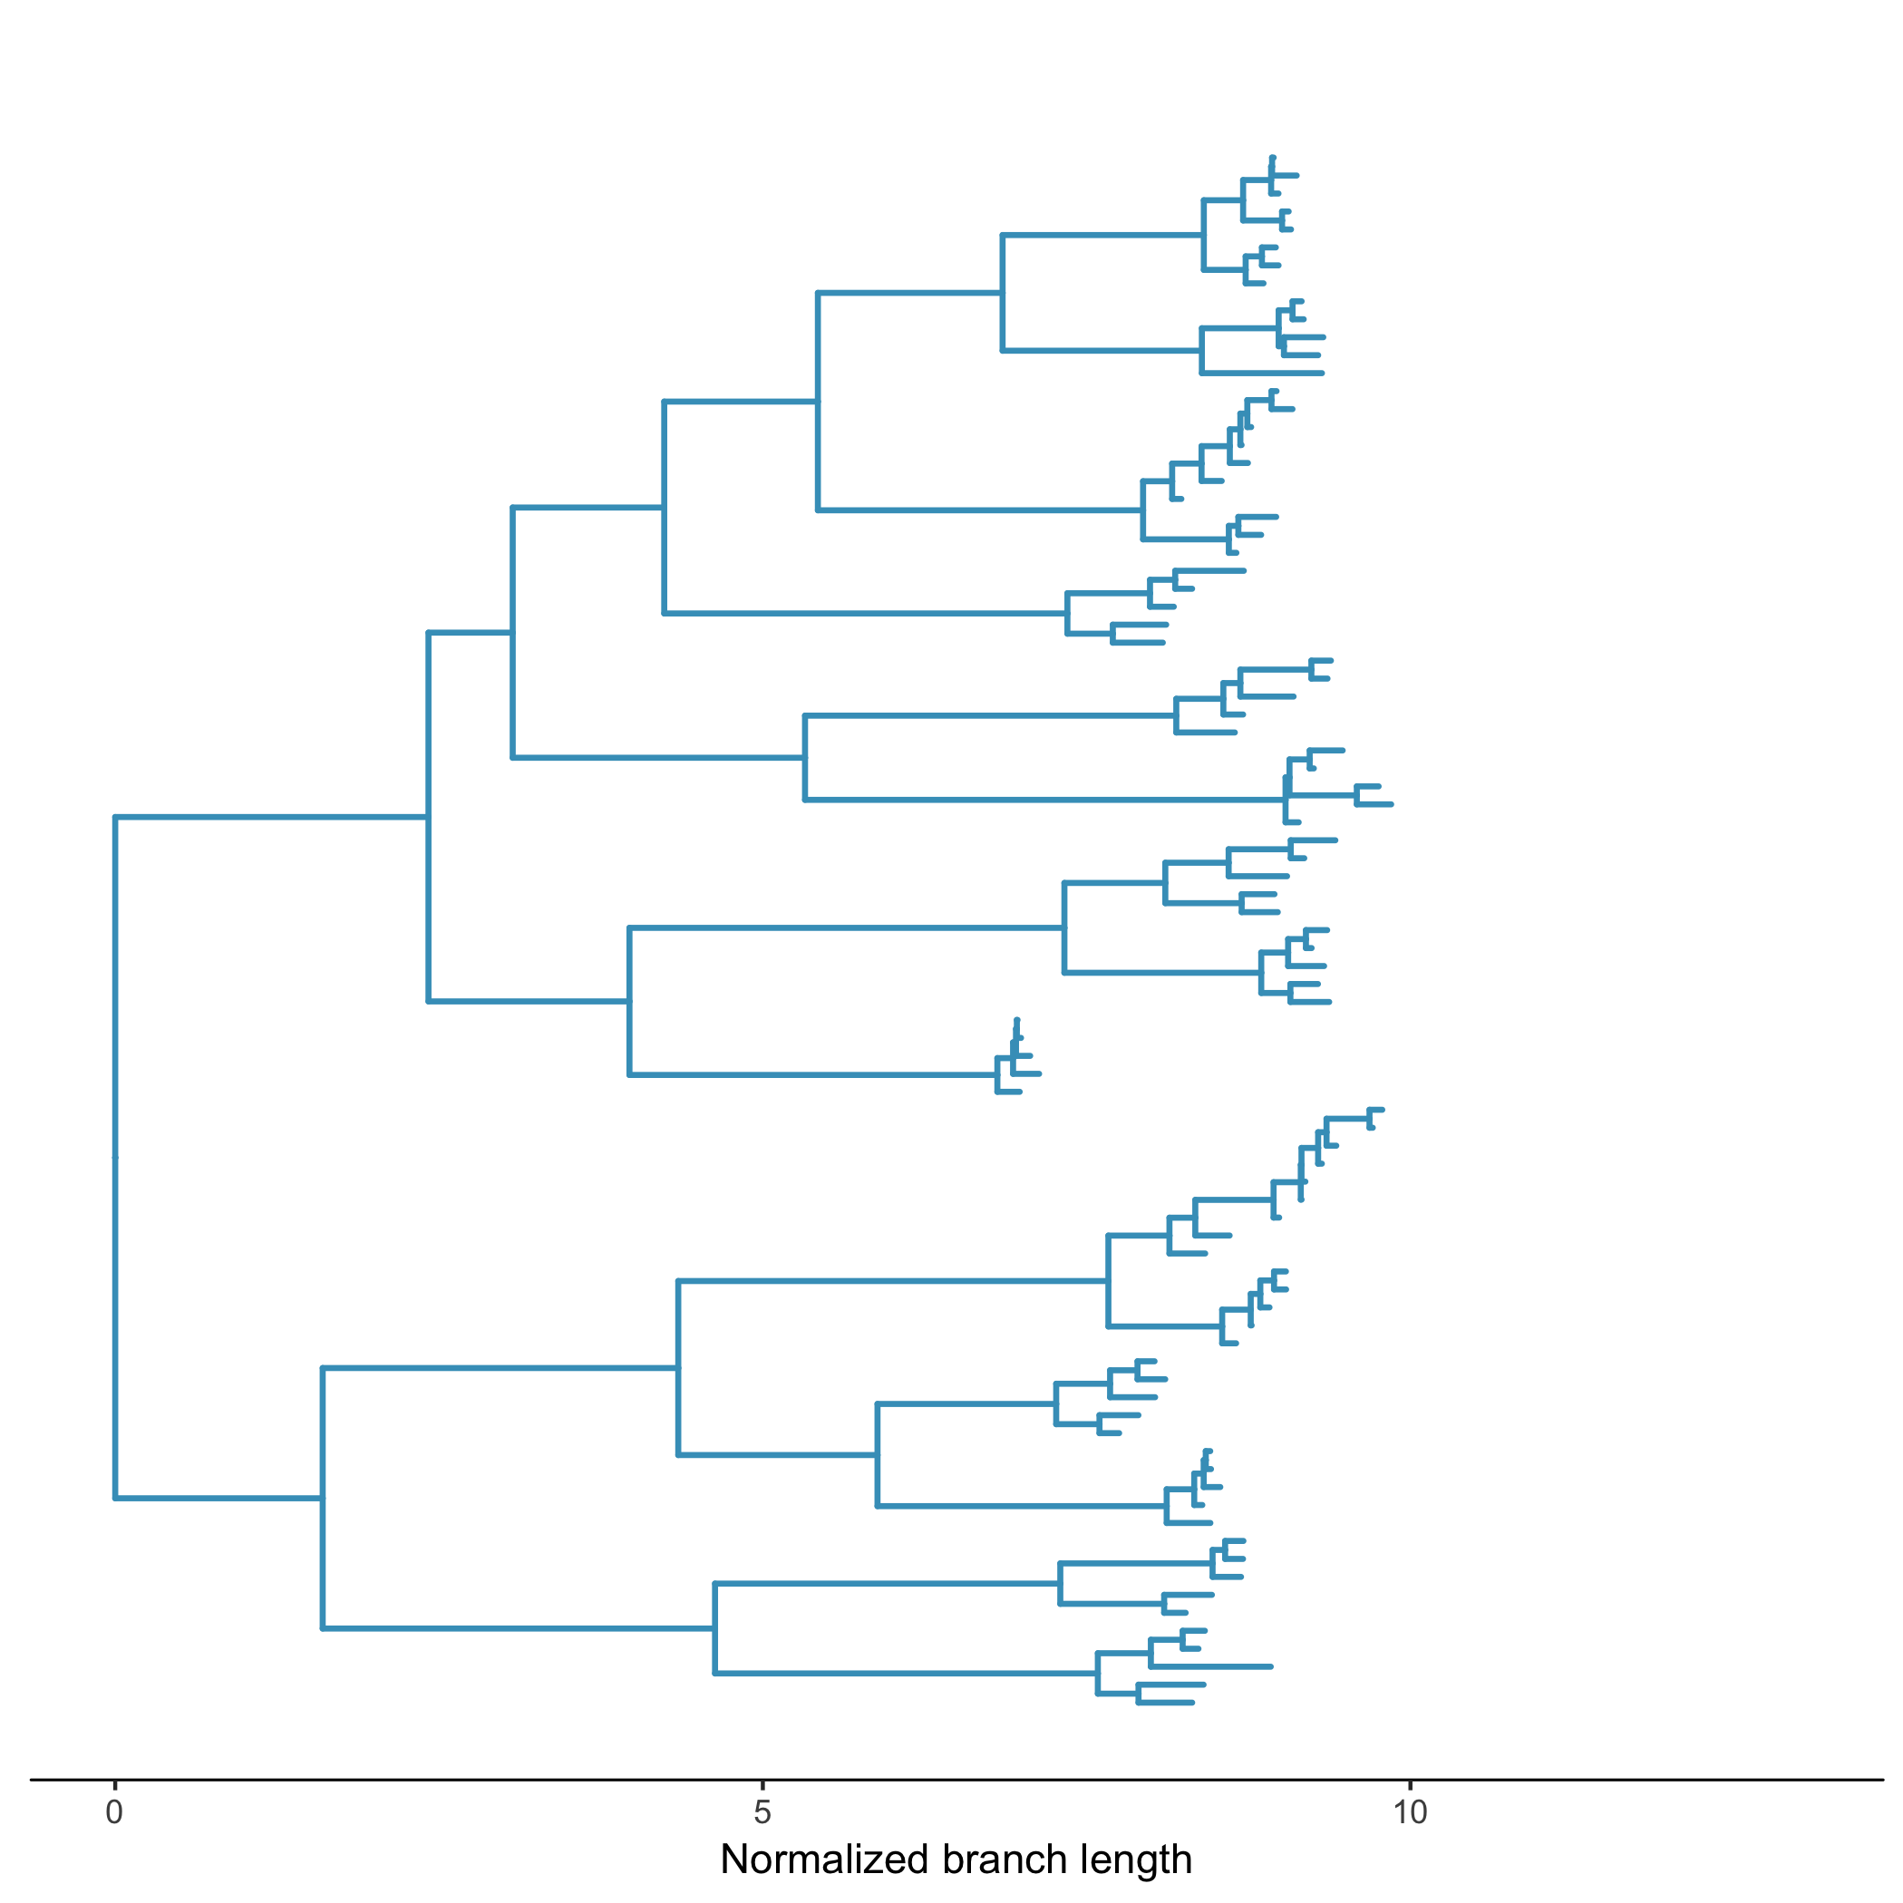







A
high
B
low
ExpCM
ExpCM +$Γω$
intermediate
$β$ value
Normalized branch length
low
high
intermediate
C
Branch from focal sequence?
Yes
No
ExpCM
GY94 +$Γω$
GY94
GY94
high
ExpCM
GY94 +$Γω$
GY94
GY94
intermediate
ExpCM
GY94 +$Γω$
GY94
GY94
low
ExpCM+$Γω$
ExpCM+$Γω$
ExpCM
YNGKP M5

Slide 28







A
B
low to high divergence
low to intermediate divergence
low divergence
Number of sequences
Amino-acid divergence from focal sequence
Branch length
(average nucleotide substitutions per site)
C
D
Branch from focal sequence?
Yes
No
Model
ExpCM
ExpCM
YNKGP M5
YNKGP M0
YNKGP M0
high
ExpCM + $Γω$
Divergence level
$β$ value
ExpCM
YNKGP M5
YNKGP M0
YNKGP M0
intermediate
Branch length
ExpCM
YNKGP M5
YNKGP M0
YNKGP M0
low
ExpCM+$Γω$
ExpCM+$Γω$
ExpCM
YNGKP M5
Branch length
low
intermediate
high
Divergence from focal sequence

